Slide 1


Slide 2

23
FINANCE, SAVING, AND INVESTMENT
Notes:
Notes and teaching tips: 5, 6, 11, 13, 17, 28, 34, 36, and 37.
To view a full-screen figure during a class, click the expand button.
To return to the previous slide, click the shrink button.
To advance to the next slide, click anywhere on the full screen figure.
Applying the principles of economics to interpret and understand the news is a major goal of the principles course. You can encourage your students in this activity by using the two features: Economics in the News and Economics in Action.
(1) Before each class, scan the news and select two or three headlines that are relevant to your session today. There is always something that works. Read the headline and ask for comments, interpretation, discussion. Pose questions arising from it that motivate today’s class. At the end of the class, return to the questions and answer them with the tools you’ve been explaining.
(2) Once or twice a semester, set an assignment, for credit, with the following instructions:
(a) Find a news article about an economic topic that you find interesting.
(b) Make a short bullet-list summary of the article.
(c) Write and illustrate with appropriate graphs an economic analysis of the key points in the article.
Use the Economics in the News features in your textbook as models.

Slide 3
After studying this chapter, you will be able to:
Describe the flows of funds through financial markets and the financial institutions
Explain how borrowing and lending decisions interact in financial markets
Explain the effects of government borrowing and lending in financial markets

Slide 4
Financial Institutions and
Financial Markets
  To study the economics of financial institutions and markets we distinguish between
  Finance and money
  Physical capital and financial capital
  Finance and Money
  The study of finance looks at how households and firms obtain and use financial resources and how they cope with the risks that arise in this activity.
  The study of money looks at how households and firms use it, how much of it they hold, how banks create and manage it, and how its quantity influences the economy.

Slide 5
Financial Institutions and
Financial Markets
  Physical Capital and Financial Capital
  Physical capital is the tools, instruments, machines, buildings, and other items that have been produced in the past and that are used today to produce goods and services.
  The funds that firms use to buy physical capital are called financial capital.
Notes:
Definitions and the meaning of investment in economics. The student has met the key definitions of investment in this chapter, but to be absolutely sure that they are remembered it is worth emphasizing that in economics, “capital” and “investment” without any qualification mean physical capital and purchase of newly produced physical capital goods. Everyday usage of investment as the purchase of stocks or bonds can lead to confusion. So it is worth getting these matters clear right from the start.

Slide 6
Financial Institutions and
Financial Markets
  Capital and Investment
  Gross investment is the total amount spent on purchases of new capital and on replacing depreciated capital.
  Depreciation is the decrease in the quantity of capital that results from wear and tear and obsolescence.
  Net investment is the change in the quantity of capital.
  Net investment = Gross investment − Depreciation.
Notes:
A concrete understanding of stock and flow variables is an important building block to understanding economic principles. You can use “buckets” to convey the relationship between stock and flow variables. Buckets are easy to draw along with a simple faucet and hole in the bucket. You can use this illustration to show how the stock changes over time due to the inflow and outflow of material into the bucket. You can extend the use of buckets to any stock/flow concept like wealth or other resources.

Slide 7
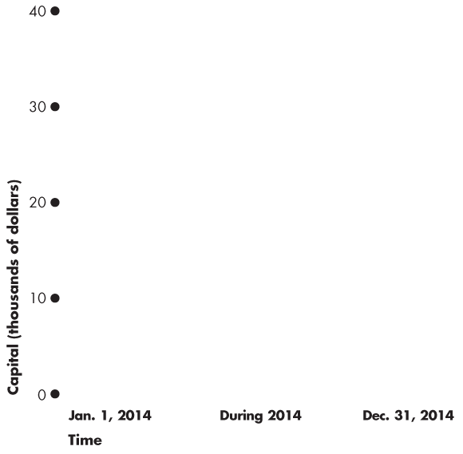
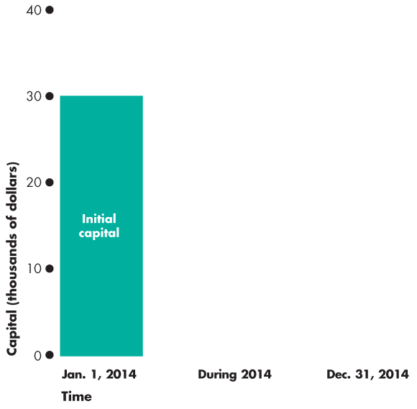
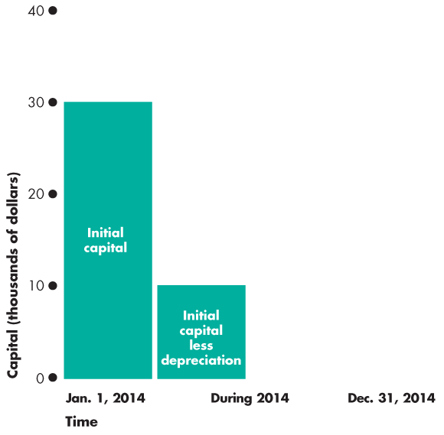
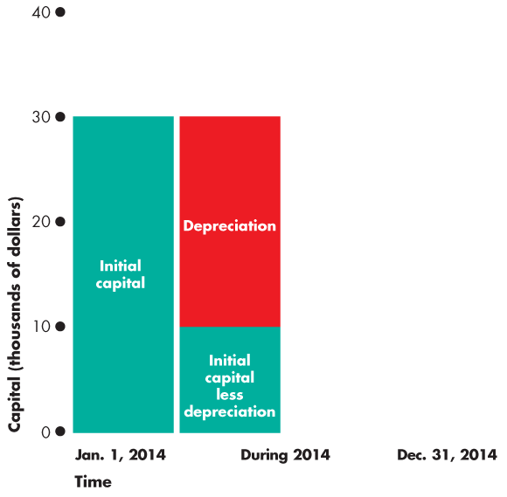
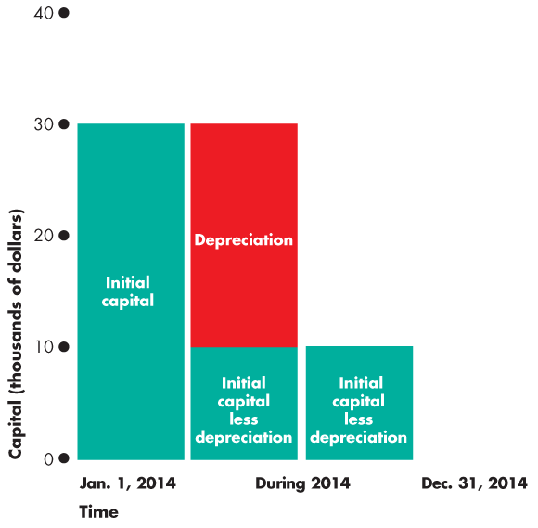
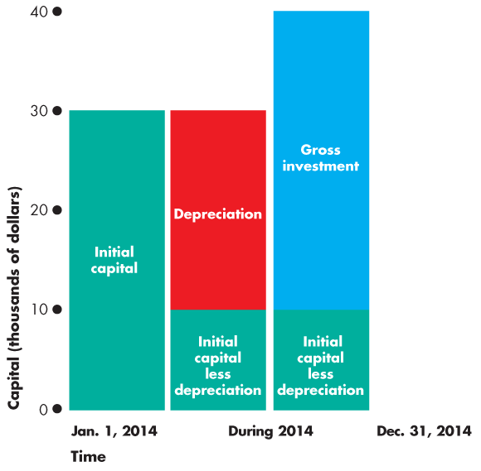
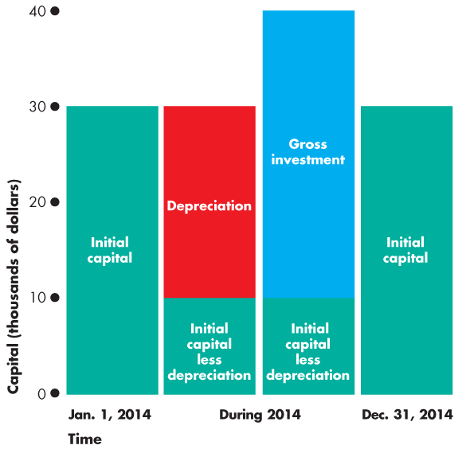
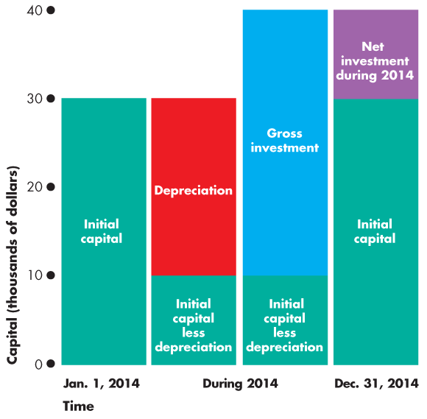
Financial Institutions and
Financial Markets
  Figure 23.1 illustrates the relationships among the capital, gross investment, depreciation, and net investment.

Slide 9
Financial Institutions and
Financial Markets
  Wealth and Saving
  Wealth is the value of all the things that people own.
  Saving is the amount of income that is not paid in taxes or spent on consumption goods and services.
  Saving increases wealth.
  Wealth also increases when the market value of assets rises—called capital gains—and decreases when the market value of assets falls—called capital losses.

Slide 10
Financial Institutions and
Financial Markets
  Financial Capital Markets
  Saving is the source of funds used to finance investment.
  These funds are supplied and demanded in three types of financial markets:
  Loan markets
  Bond markets
  Stock markets

Slide 11
Financial Institutions and
Financial Markets
  Financial Institutions
  A financial institution is a firm that that operates on both sides of the markets for financial capital.
  It is a borrower in one market and a lender in another.
  Key financial institutions are
  Banks
  Trust and Loan Companies
  Credit Unions and Caisses Populaires
  Pension funds
  Insurance companies
Notes:
Financial Crisis: The fall of 2008 saw the biggest financial crisis since the Great Depression. Essentially securities, such as mortgage-backed securities, lost value and many financial institutions became insolvent. These institutions, such as Fannie Mae, Freddie Mac, Bear Sterns, AIG, and others were considered “too large” to fail. While you cannot fully explain the reasons why failure of a large financial institution might have external costs, your students can readily appreciate the point that if these institutions failed many borrowers would find it significantly more costly to arrange loans. The government acted in most all of these cases by arranging a bailout in form or another. Some companies were given government loans (AIG received an $85 billion loan from the Fed); others were taken into government oversight (Fannie Mae and Freddie Mac); others were merged into healthier companies, albeit with government assistance (Bear Sterns); a few were allowed to fail (Lehman Brothers).Even beyond these events, most financial institutions were given government assistance in the form of government loans and/or government purchase of stock.
Classroom activity
Check out Economics in Action: The Financial Crisis

Slide 12
Financial Institutions and
Financial Markets
  Insolvency and Illiquidity
  A financial institution’s net worth is the total market value of what it has lent minus the market value of what it has borrowed.
  If net worth is positive, the institution is solvent and can remain in business.
  But if net worth is negative, the institution is insolvent and go out of business.

Slide 13
Financial Institutions and
Financial Markets
  Interest Rates and Asset Prices
  The interest rate on a financial asset is the interest received expressed as a percentage of the price of the asset.
  For example, if the price of the asset is $50 and the interest is $5, then the interest rate is 10 percent.
  If the asset price rises (say to $200), other things remaining the same, the interest rate falls (2.5 percent).
  If the asset price falls (say to $20), other things remaining the same, the interest rate rises (to 25 percent).
Notes:
It is helpful to show explicitly how the market price of a bond is determined by the current interest rate. Using an example of government bond will be useful for future chapters on monetary and fiscal policy. Explain that a bond is an “IOU” from the issuer and its basic components of are its term, face value and coupon payment. For example, a bond might have a $10,000 face value with a coupon payment of $500 for the next 5 years. Point out to your students that this coupon payment means that the bond is essentially paying an interest rate of 5 percent for the next five years…at least as long as its price is $10,000. Explain how the bond can be traded in the secondary market and ask them what they think the bond’s price would be if the market interest rate rose to 6 percent. Make clear that when the interest rate rises to 6 percent, that means that “new” government bonds with a $10,000 face value will sell for $10,000 and will pay a $600 coupon payment. Your students should be able to see that the “old” bond must be worth less than the new bond because the old bond has a smaller coupon payment. Tell your students that while it is possible to determine the precise price for which the old bond will trade, your key point is that the price has fallen from $10,000 to something less. In other words, an increase in the interest rate has lowered the pierce of (old) bonds!

Slide 14
The Loanable Funds Market
  The market for loanable funds is the aggregate of all the individual financial markets.
  Funds that Finance Investment
  Funds come from three sources:
  1. Household saving S
  2. Government budget surplus (T – G)
  3. Borrowing from the rest of the world (M – X)
  Figure 23.2 on the next slide illustrates the flows of funds that finance investment.

Slide 15
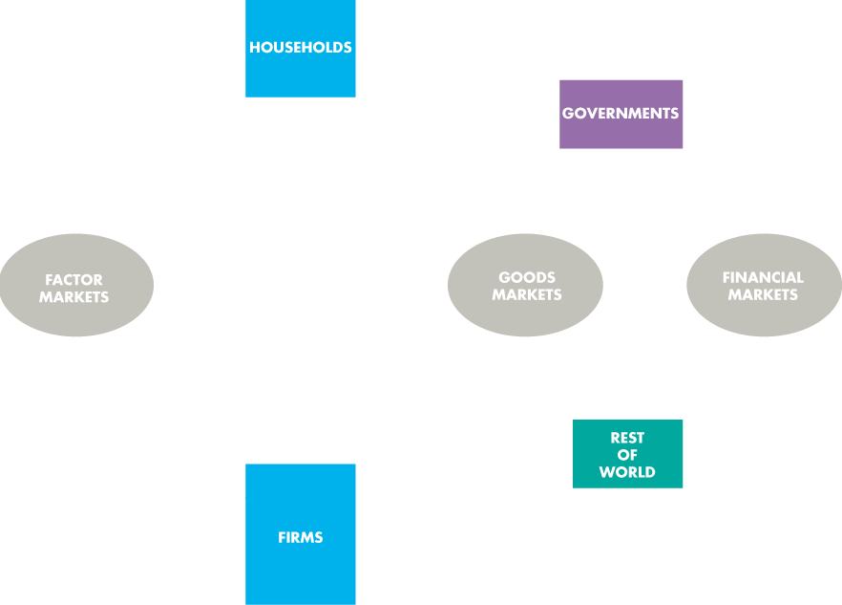
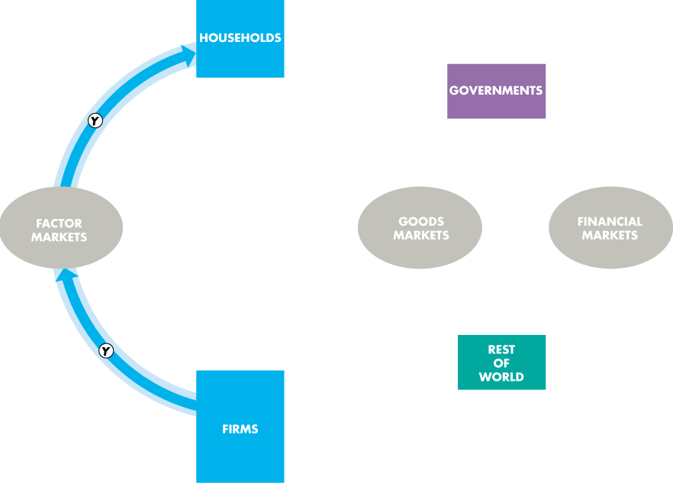
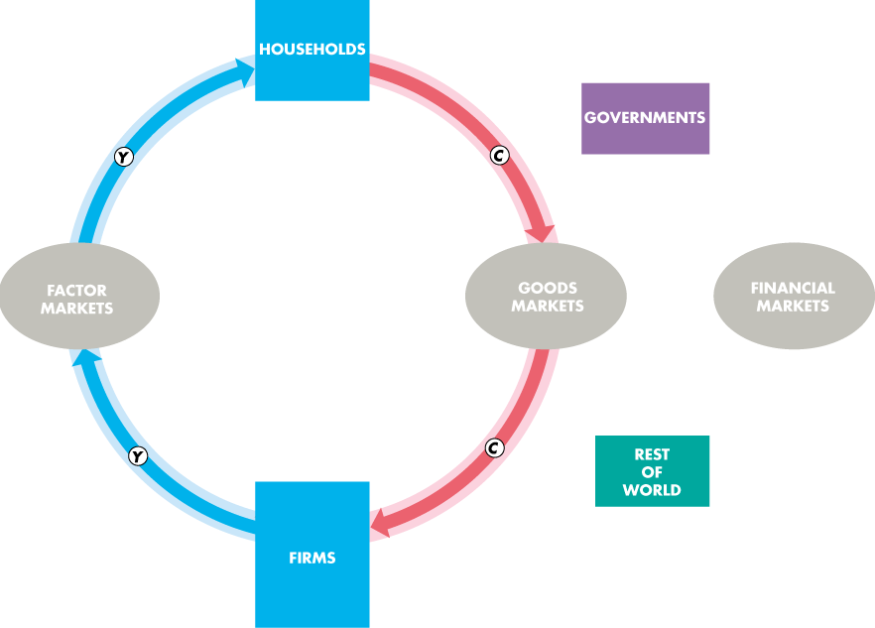
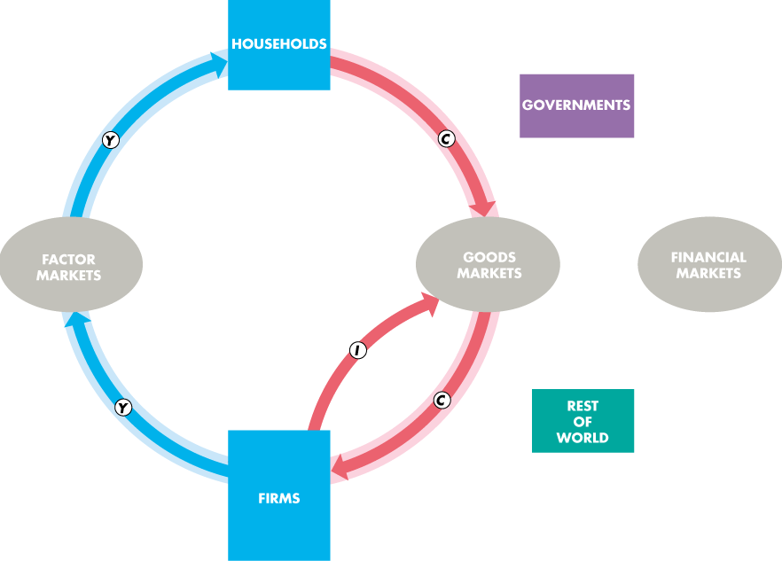

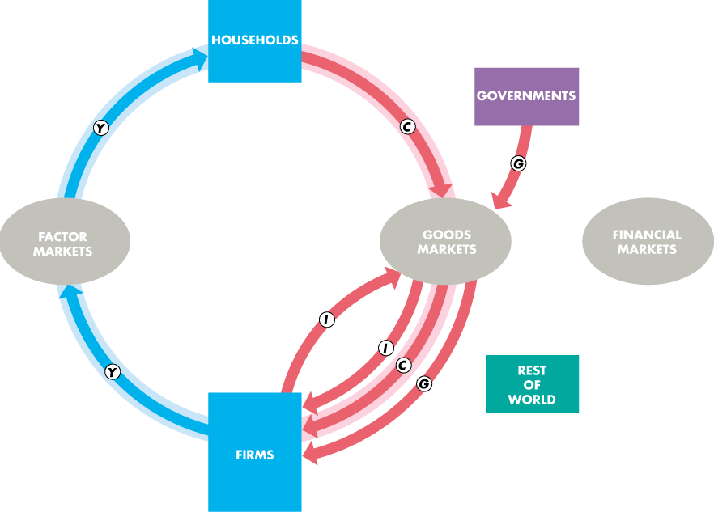
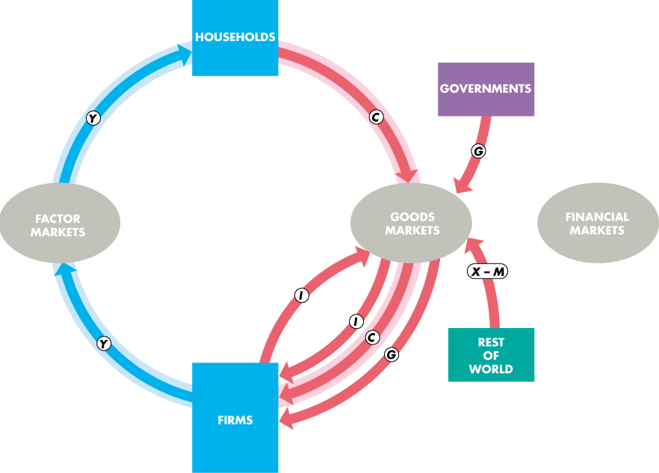
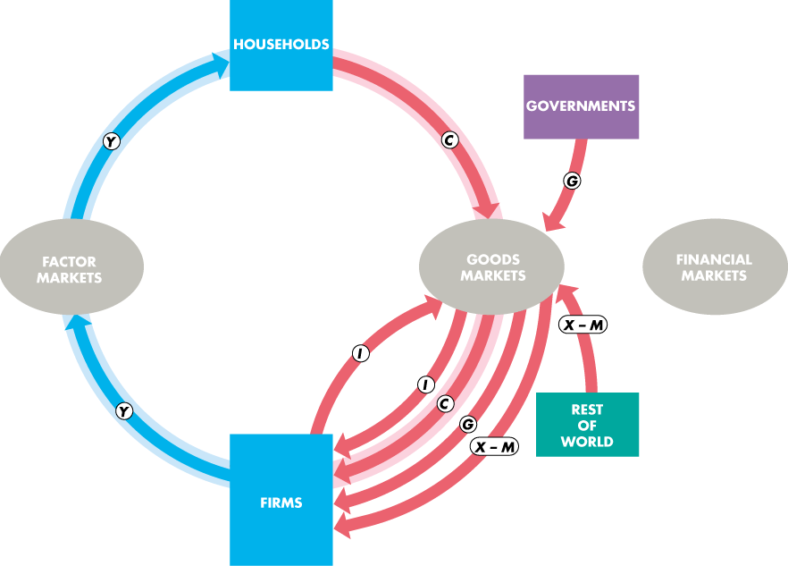
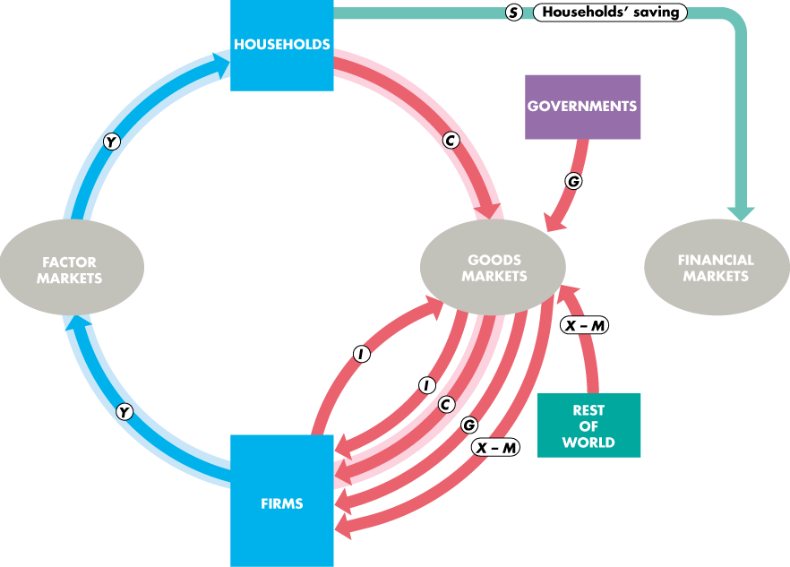
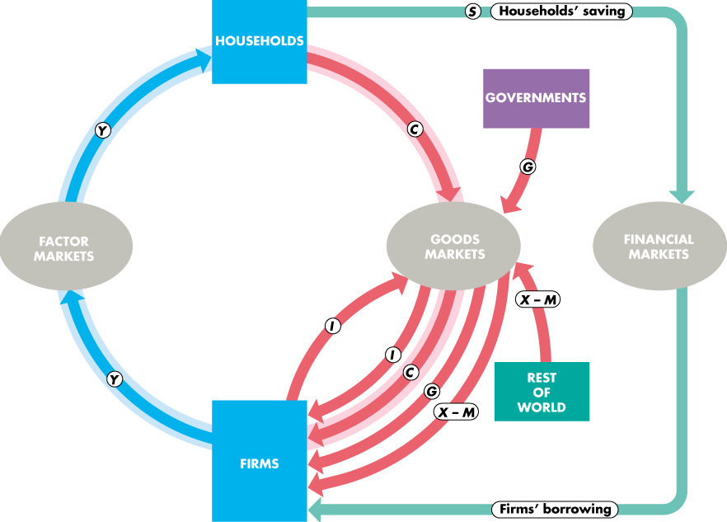
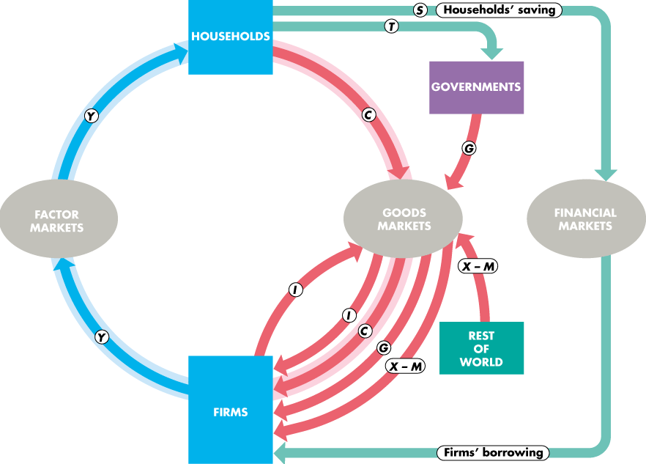
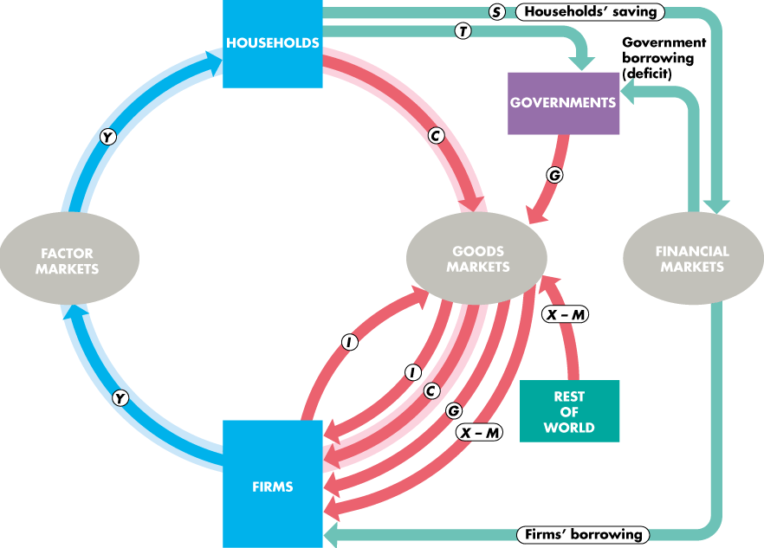
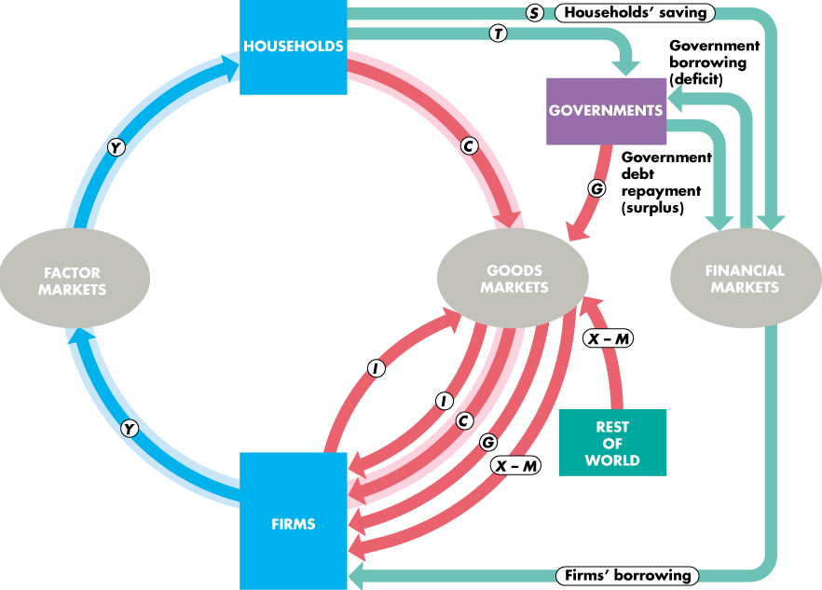
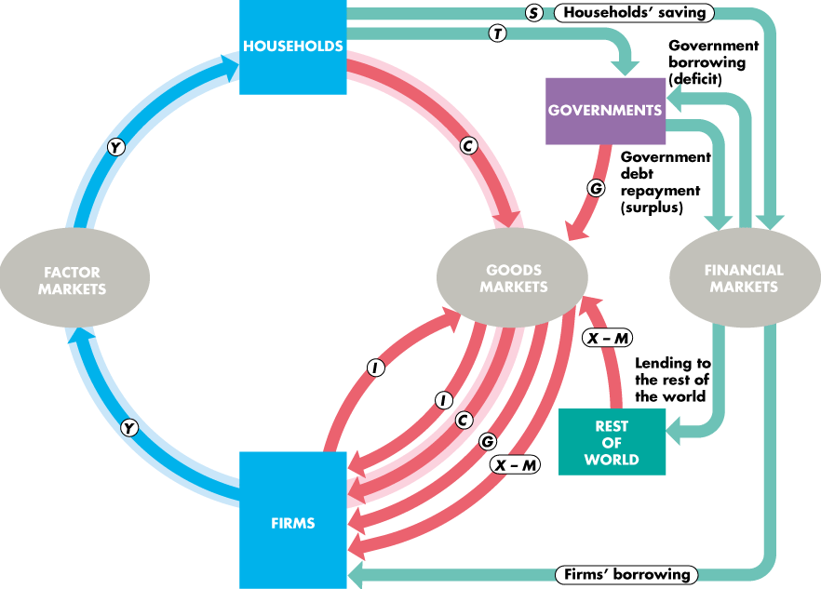
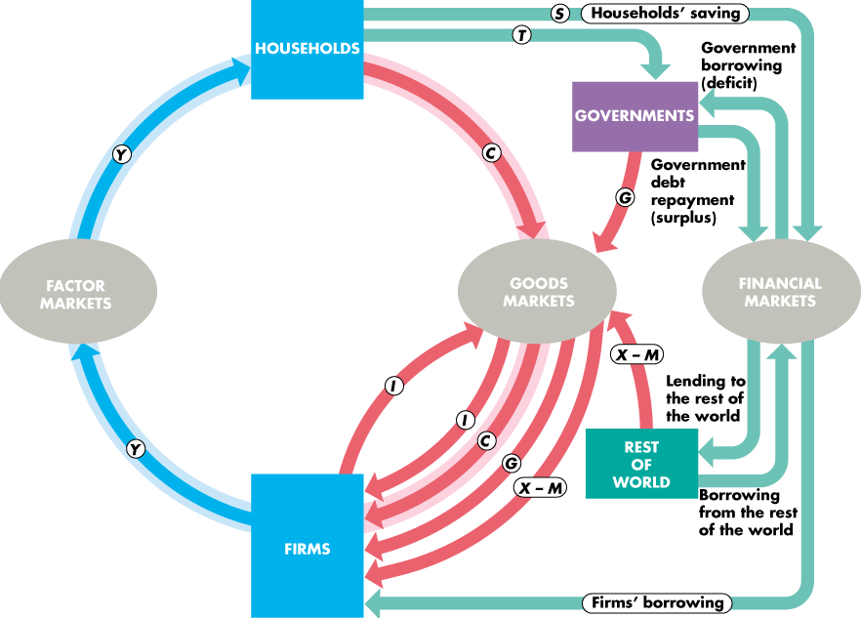

Slide 16
The Loanable Funds Market
  The Real Interest Rate
  The nominal interest rate is the number of dollars that a borrower pays and a lender receives in interest in a year expressed as a percentage of the number of dollars borrowed and lent.
  For example, if the annual interest paid on a $500 loan is $25, the nominal interest rate is 5 percent per year.

Slide 17
The Loanable Funds Market
  The real interest rate is the nominal interest rate adjusted to remove the effects of inflation on the buying power of money.
  The real interest rate is approximately equal to the nominal interest rate minus the inflation rate.
  For example, if the nominal interest rate is 5 percent a year and the inflation rate is 2 percent a year, the real interest rate is 3 percent a year.
  The real interest rate is the opportunity cost of borrowing.
Notes:
Real versus nominal interest rate. To drive home the distinction between the nominal interest rate and real interest rate, ask your class if an interest rate of 10 percent is high. Almost assuredly they will respond with a resounding “Yes.” Point out to them that around 1980 a 10 percent interest rate was exceedingly low. At the time a typical interest rate was between 12 percent and 17 percent, depending on the riskiness of the asset and the length of the loan. What accounts for the difference between then and now? The answer is simple: inflation. In 1980 the inflation rate was running at more than 10 percent per year. Given the high inflation rate, the nominal interest rate adjusted so that it, too, was high. Most of the dollars lenders received as (nominal) interest went to keeping their purchasing power intact. But the real interest rate at that time was not much different than the real interest rate nowadays. In other words, the increase in purchasing power received by lenders (the real interest rate) in the 1980s was about the same as the increase in purchasing power received by lenders today.
Classroom activity
Check out Economics in Action: Nominal and Real Interest Rates

Slide 18
The Loanable Funds Market
  The market for loanable funds determines the real interest rate, the quantity of funds loaned, saving, and investment.
  We’ll start by ignoring the government and the rest of the world.
  The Demand for Loanable Funds
  The quantity of loanable funds demanded depends on
  1. The real interest rate
  2. Expected profit

Slide 19
The Loanable Funds Market
The Demand for Loanable Funds Curve
  The demand for loanable funds is the relationship between the quantity of loanable funds demanded and the real interest rate when all other influences on borrowing plans remain the same.
  Business investment is the main item that makes up the demand for loanable funds.

Slide 20
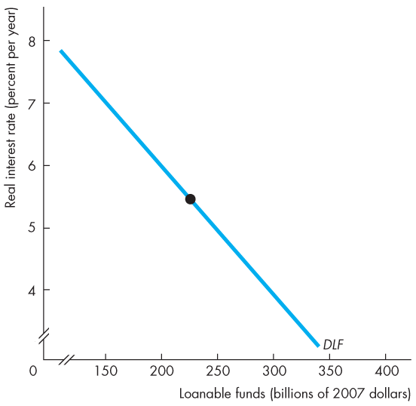
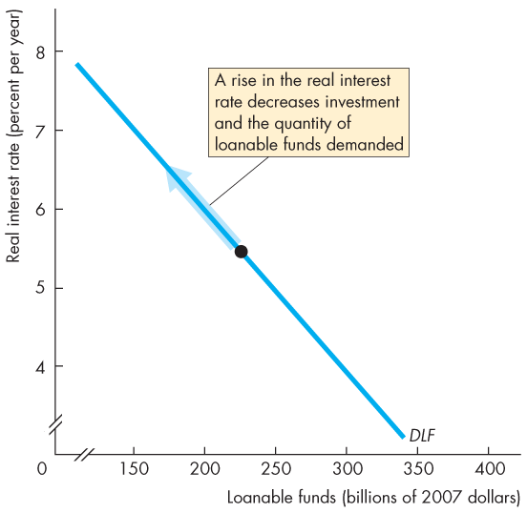
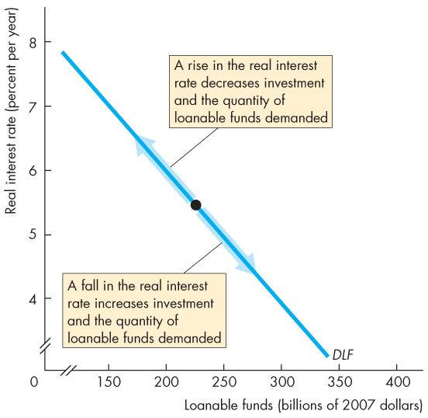
The Market for Loanable Funds
  Figure 23.3 shows the demand for loanable funds curve.
  A rise in the real interest rate decreases the quantity of loanable funds demanded.
  A fall in the real interest rate increases the quantity of loanable funds demanded.

Slide 22
The Loanable Funds Market
Changes in the Demand for Loanable Funds
  When the expected profit changes, the demand for loanable funds changes.
  Other things remaining the same, the greater the expected profit from new capital, the greater is the amount of investment and the greater the demand for loanable funds.

Slide 23
The Loanable Funds Market
  The Supply of Loanable Funds
  The quantity of loanable funds supplied depends on
  1. The real interest rate
  2. Disposable income
  3. Expected future income
  4. Wealth
  5. Default risk

Slide 24
The Loanable Funds Market
The Supply of Loanable Funds Curve
  The supply of loanable funds is the relationship between the quantity of loanable funds supplied and the real interest rate when all other influences on lending plans remain the same.
  Saving is the main item that makes up the supply of loanable funds.

Slide 25
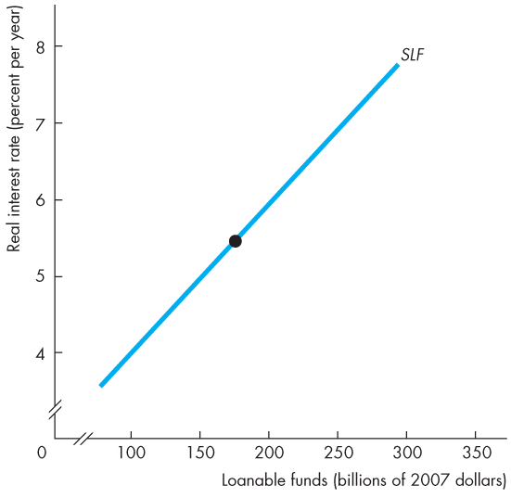
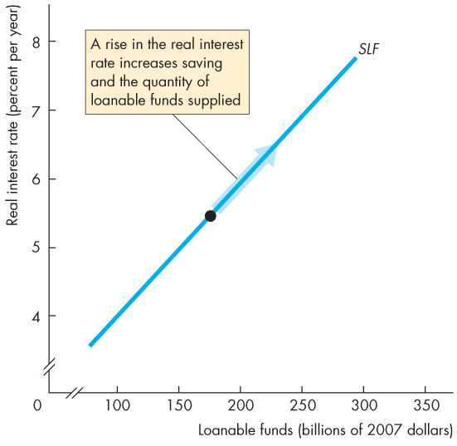
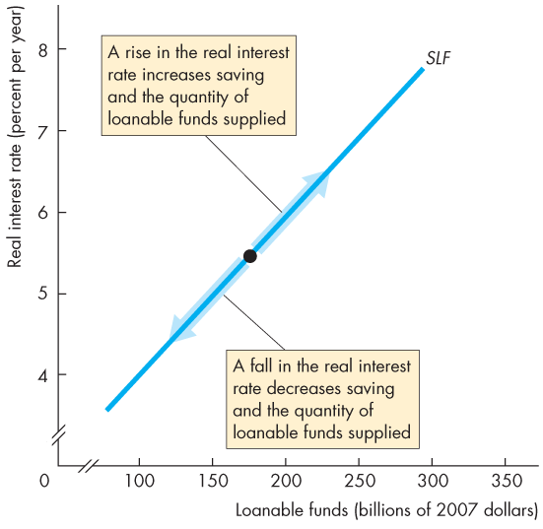
The Market for Loanable Funds
  Figure 23.4 shows the supply of loanable funds curve.
  A rise in the real interest rate increases the quantity of loanable funds supplied.
  A fall in the real interest rate decreases the quantity of loanable funds supplied.

Slide 27
The Loanable Funds Market
Changes in the Supply of Loanable Funds
  A change in disposable income, expected future income, wealth, or default risk changes the supply of loanable funds.
  An increase in disposable income, a decrease in expected future income, a decrease in wealth, or a fall in default risk increases saving and increases the supply of loanable funds.

Slide 28
The Loanable Funds Market
  Equilibrium in the Loanable Funds Market
  The loanable funds market is in equilibrium at the real interest rate at which the quantity of loanable funds demanded equals the quantity of loanable funds supplied.
Notes:
Classroom activity
Check out Economics in Action: The Total Quantities Supplied and Demanded

Slide 29
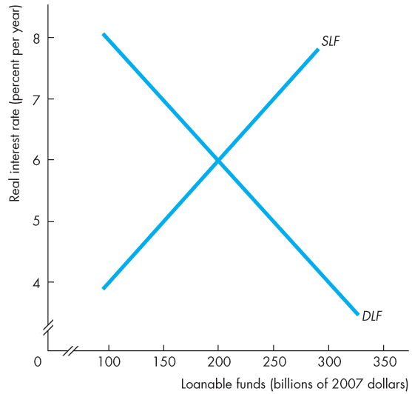
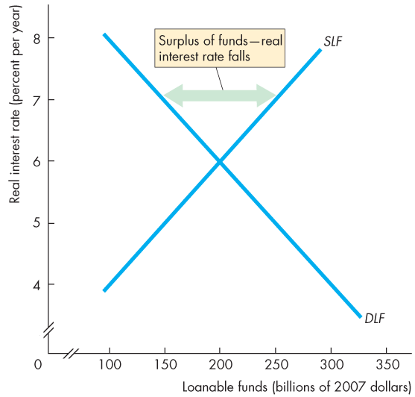
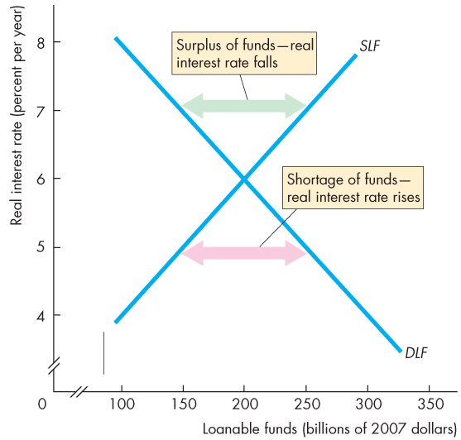
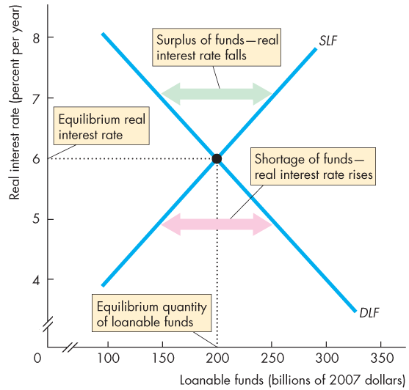
The Loanable Funds Market
  Figure 23.5 illustrates the loanable funds market.
  At 7 percent a year, there is a surplus of funds and the real interest rate falls.
  At 5 percent a year, there is a shortage of funds and the real interest rate rises.
  Equilibrium occurs at a real interest rate of 6 percent a year.

Slide 31
The Loanable Funds Market
  Changes in Demand and Supply
  Financial markets are highly volatile in the short run but remarkably stable in the long run.
  Volatility comes from fluctuations in either the demand for loanable funds or the supply of loanable funds.
  These fluctuations bring fluctuations in the real interest rate and in the equilibrium quantity of funds lent and borrowed.
  They also bring fluctuations in asset prices.

Slide 32
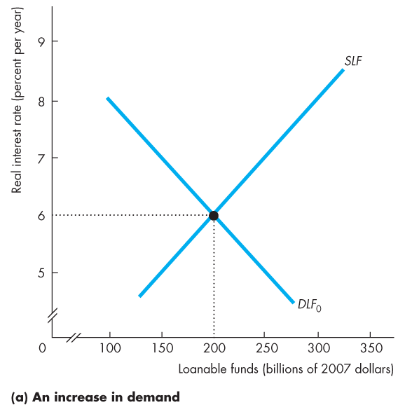
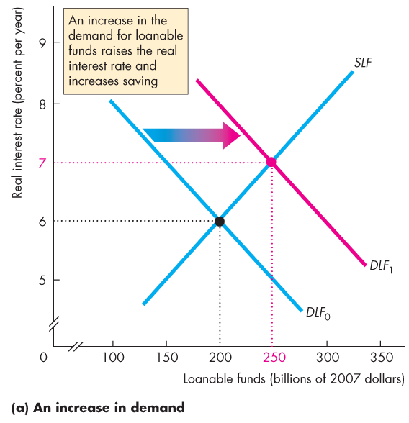
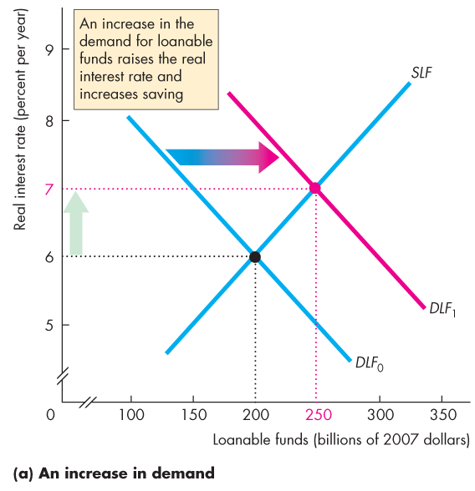
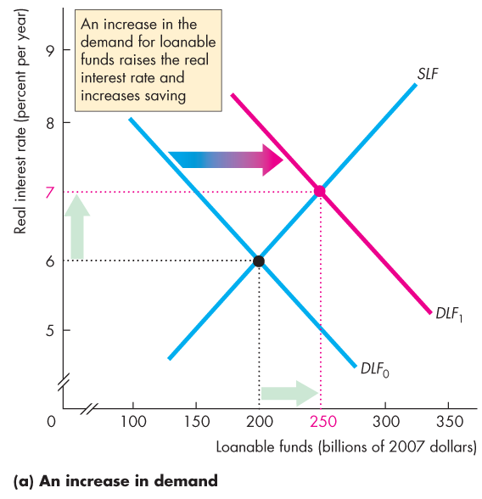
The Loanable Funds Market
  Figure 23.6(a) illustrates an increase in the demand for loanable funds.
  An increase in expected profits increases the demand for funds today.
  The real interest rate rises.
  Saving and quantity of funds supplied increases.

Slide 34
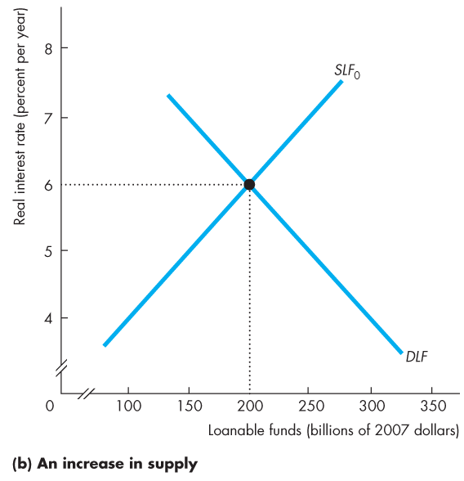
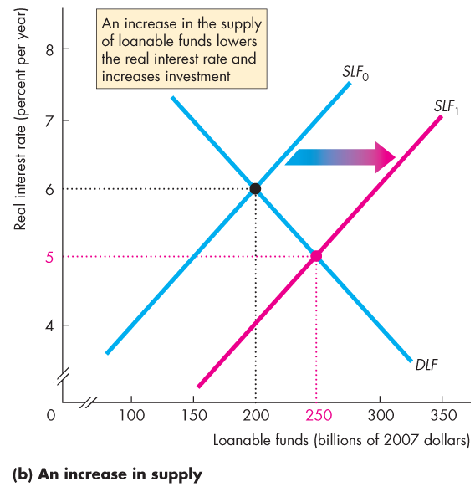
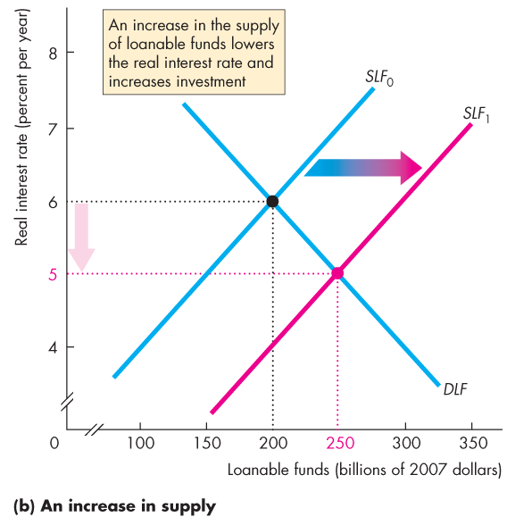

The Loanable Funds Market
  Figure 23.6(b) illustrates an increase in the supply of loanable funds.
  If one of the influences on saving plans changes and saving increases, the supply of funds increases.
  The real interest rate falls.
  Investment increases.
Notes:
Classroom activity
Check out Economics in Action: Loanable Funds Fuel Home Price Bubble

Slide 36
Government in the Loanable Funds Market
  Government enters the financial loanable market when it has a budget surplus or deficit.
  A government budget surplus increases the supply of funds.
  A government budget deficit increases the demand for funds.
Notes:
Take advantage of this model to highlight the effect of the deficit. Whether you draw it on the board or use a laser pointer, track the increase in the real interest rate and the decrease moving along the PDLF curve. Mention that crowding out decreases the capital stock because of the decrease in investment.

Slide 37
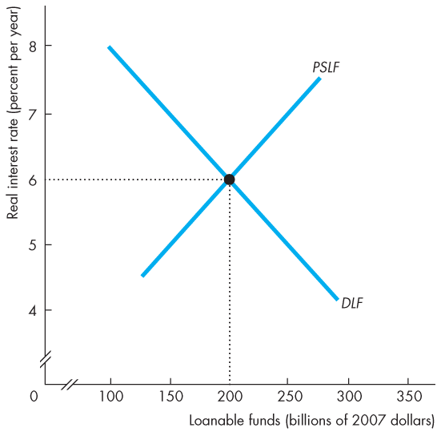
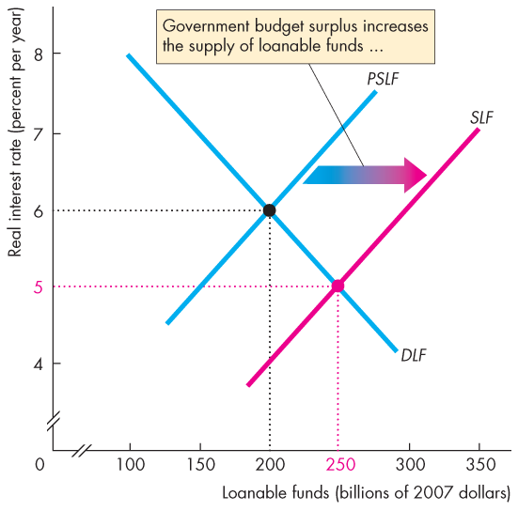
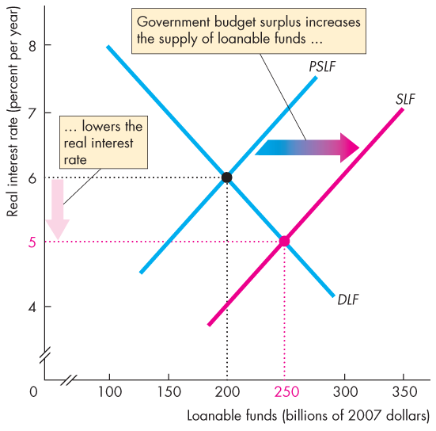
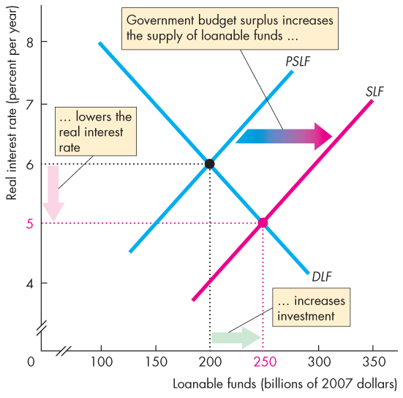
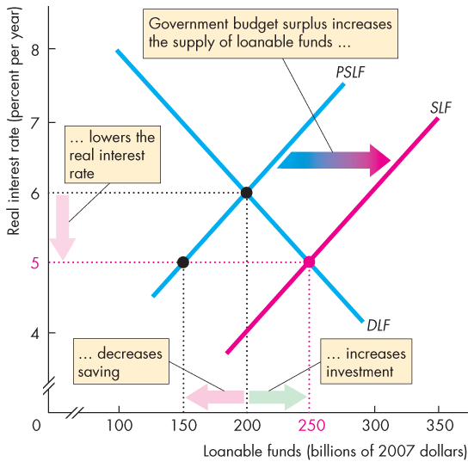
Government in the Market for Loanable Funds
  Figure 23.7 illustrates the effect of a government budget surplus.
  A government budget surplus increases the supply of funds.
  The real interest rate falls.
  Investment increases.
  Saving decreases.
Notes:
Classroom activity
Check out Economics in the News: Interest Rates Low But Fall

Slide 39
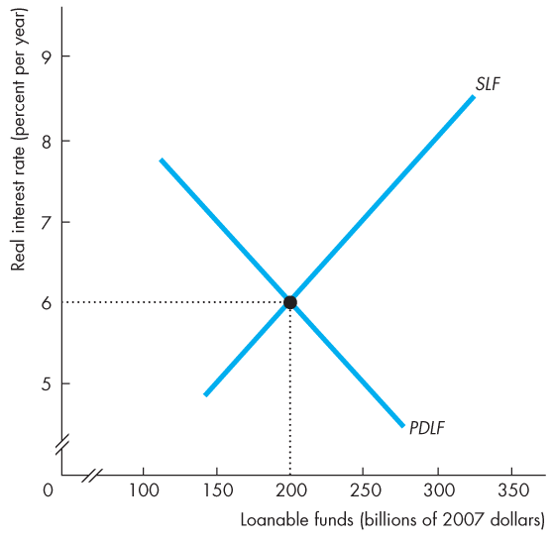
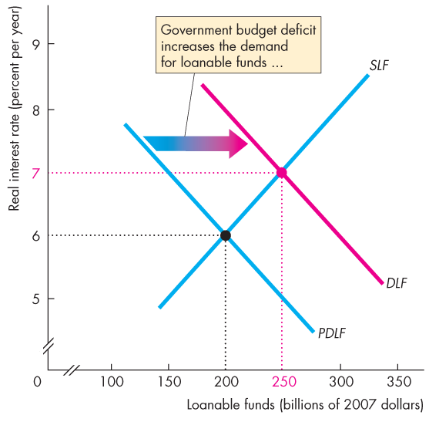
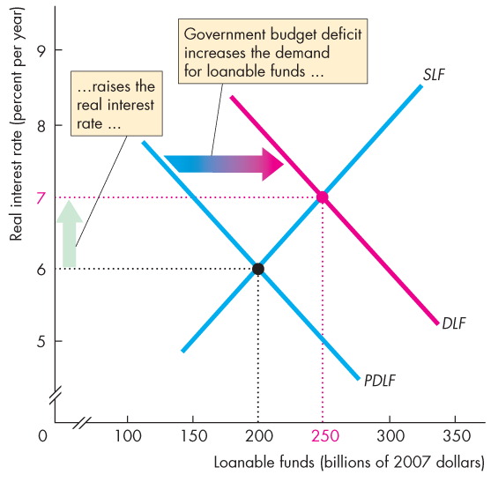
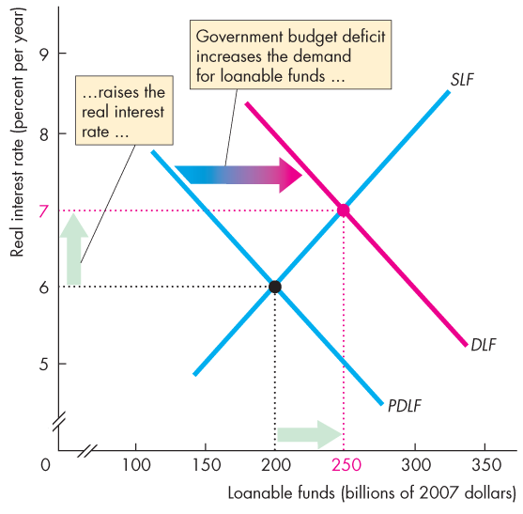
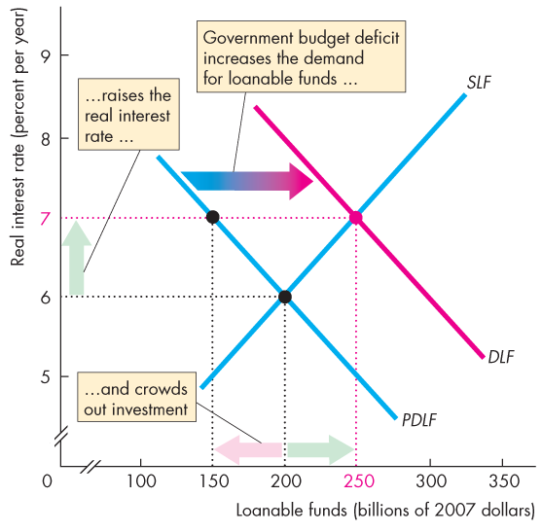
Government in the Market for Loanable Funds
  Figure 23.8 illustrates the effect of a government budget deficit.
  A government budget deficit increases the demand for funds.
  The real interest rate rises.
  Saving increases.
  Investment decreases.

Slide 41
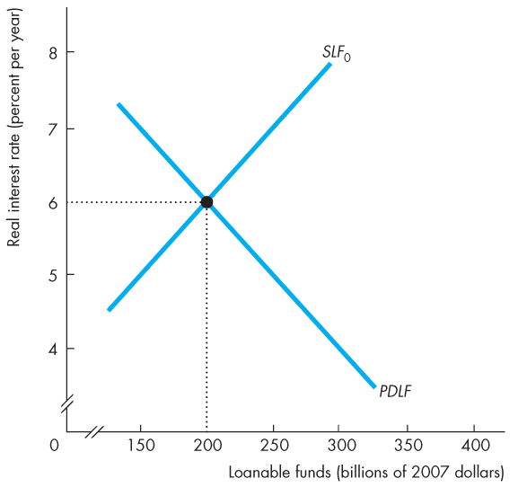



Government in the Market for Loanable Funds
  Figure 23.9 illustrates the Ricardo-Barro effect.
  A budget deficit increases the demand for funds.
  Rational taxpayers increase saving, which increases the supply of funds.
  Crowding-out is avoided.
  Increased saving finances the deficit.

